Slide 1
Computational Materials Theory and Methods
Lecture 2:
Classical Molecular Mechanics
Alexey V. Akimov
University at Buffalo, SUNY

Slide 2
Time and size scales for different methods of dynamics

Slide 3
Accuracy and methodology

Slide 4

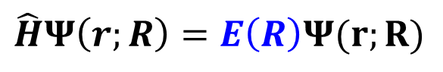
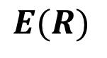
Potential energy surface (PES)
Stationary Schrodinger Equation
Computationally expensive!
Can we fit the curves with a simple analytical function?
$$\hat{H}Ψ\left(r;R\right)=E\left(R\right)Ψ(r;R)$$
$$E(R)$$
$$R$$
Within the Born-Oppenheimer Approximation

Slide 5
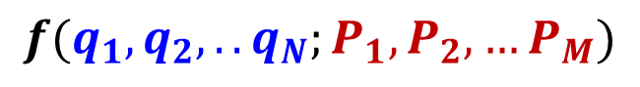
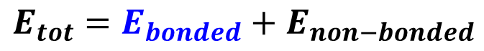
Force fields (Molecular Mechanics)
Force field
functional
parameters
$$f(q_{1},q_{2},..q_{N};P_{1},P_{2},…P_{M})$$
Numerically efficient
Has suitable derivatives
Is continuous
Physically meaningfull
Based on atom and interaction types
Minimal amount is desirable
Transferable or system-specific
Reproduce ab initio or experiment
(thermodynamic properties, spectra,
chemical reactivity, etc.)
$$E_{tot}=E_{bonded}+E_{non−bonded}$$
describes covalent bonding
non-covalent interactions

Slide 6
Bonded interactions
$$E_{bonded}=E_{bonds}+E_{angles}+E_{dihedrals}+E_{oop}$$
In quantum mechanics: bonds are everywhere “bond order”
In molecular mechanics: bonded atoms must be specified by the user

Slide 7
Non-bonded interactions
Charges are usually constant,
but there are geometry-dependent
charge schemes (e.g. qEQ)
Accounts for the polarizability
Rappe, A. K.; Goddard, W. A.
J. Phys. Chem. 1991, 95, 3358–3363.
Ogawa, T.; Kurita, N.; Sekino, H.; Kitao, O.;
Tanaka, S.
Chem. Phys. Lett. 2004, 397, 382–387.
Chen, J.; Martinez, T. J. Chem. Phys. Lett. 2007, 438, 315–320.
In periodic systems, the lattice
summation methods are used,
such as Ewald sum method.
Karasawa, N.; Goddard III, W. A.
J. Phys. Chem. 1989, 93, 7320–7327.

Slide 8
Atom types
Universal FF (UFF)
Generalized Amber FF
MERCK FF 94
Rappe, A. K.; Casewit, C. J.; Colwell, K. S.; Goddard III, W. A.; Skiff, W. M.
J. Am. Chem. Soc. 1992, 114, 10024–10035.
Wang, J.; Wolf, R. M.; Caldwell, J. W.; Kollman, P. A.; Case, D. A. J. Comput. Chem. 2004, 25, 1157–1174.
Halgren, T. A. J. Comput. Chem. 1996, 17, 490–519.
General purpose FFs
Specialized FFs

Slide 9
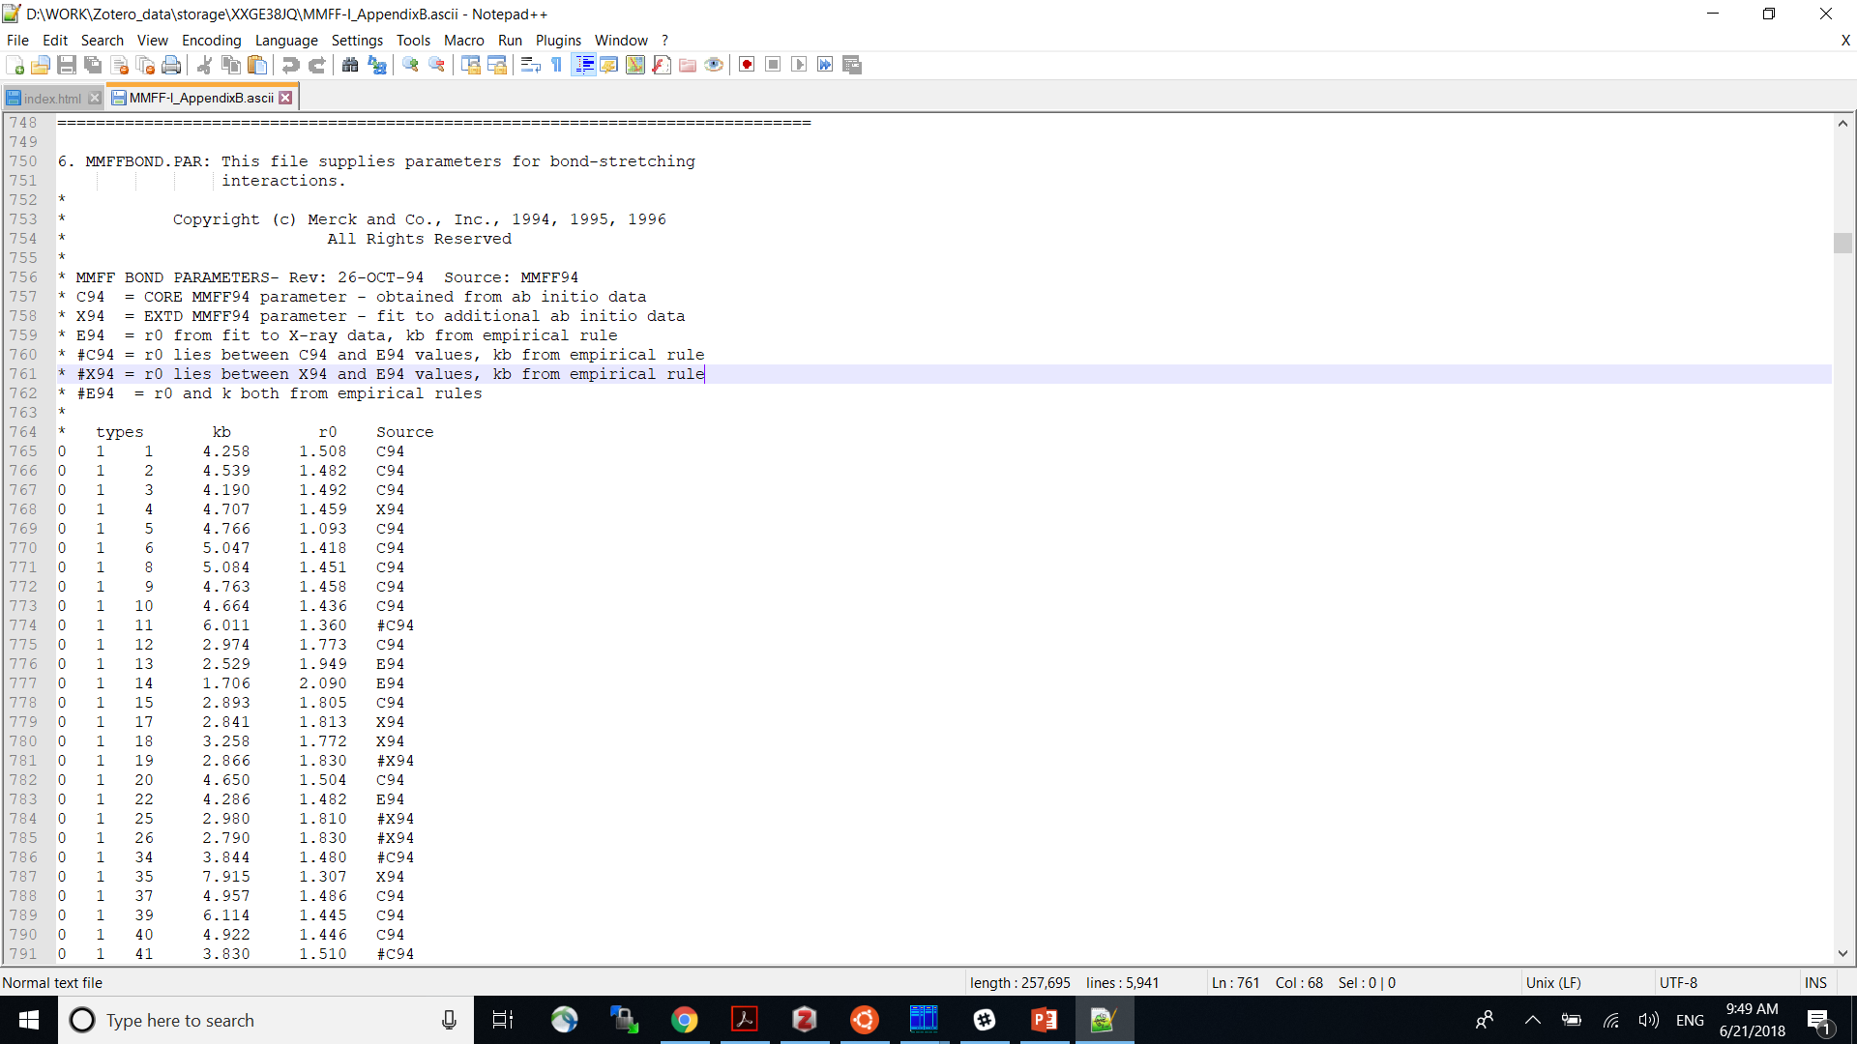
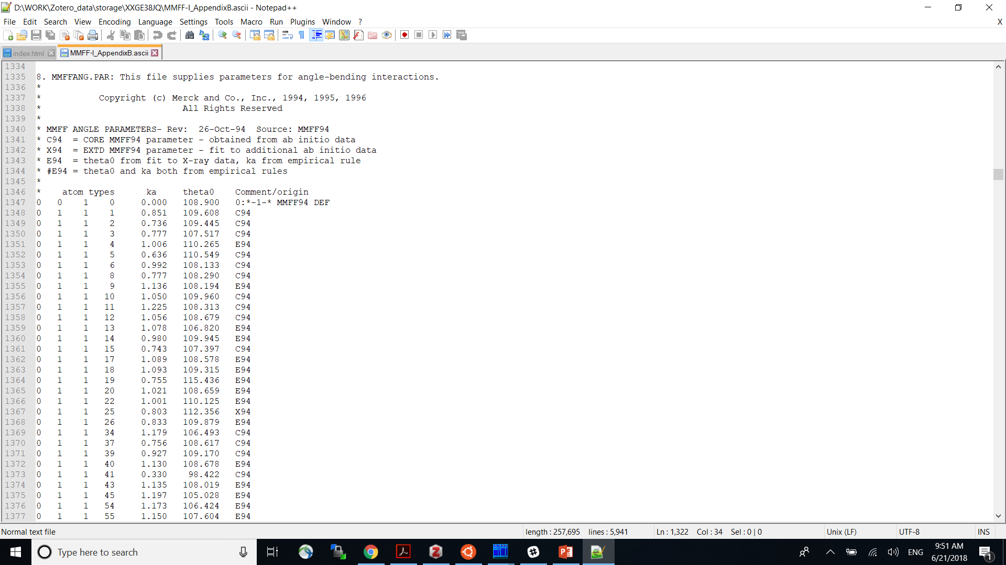
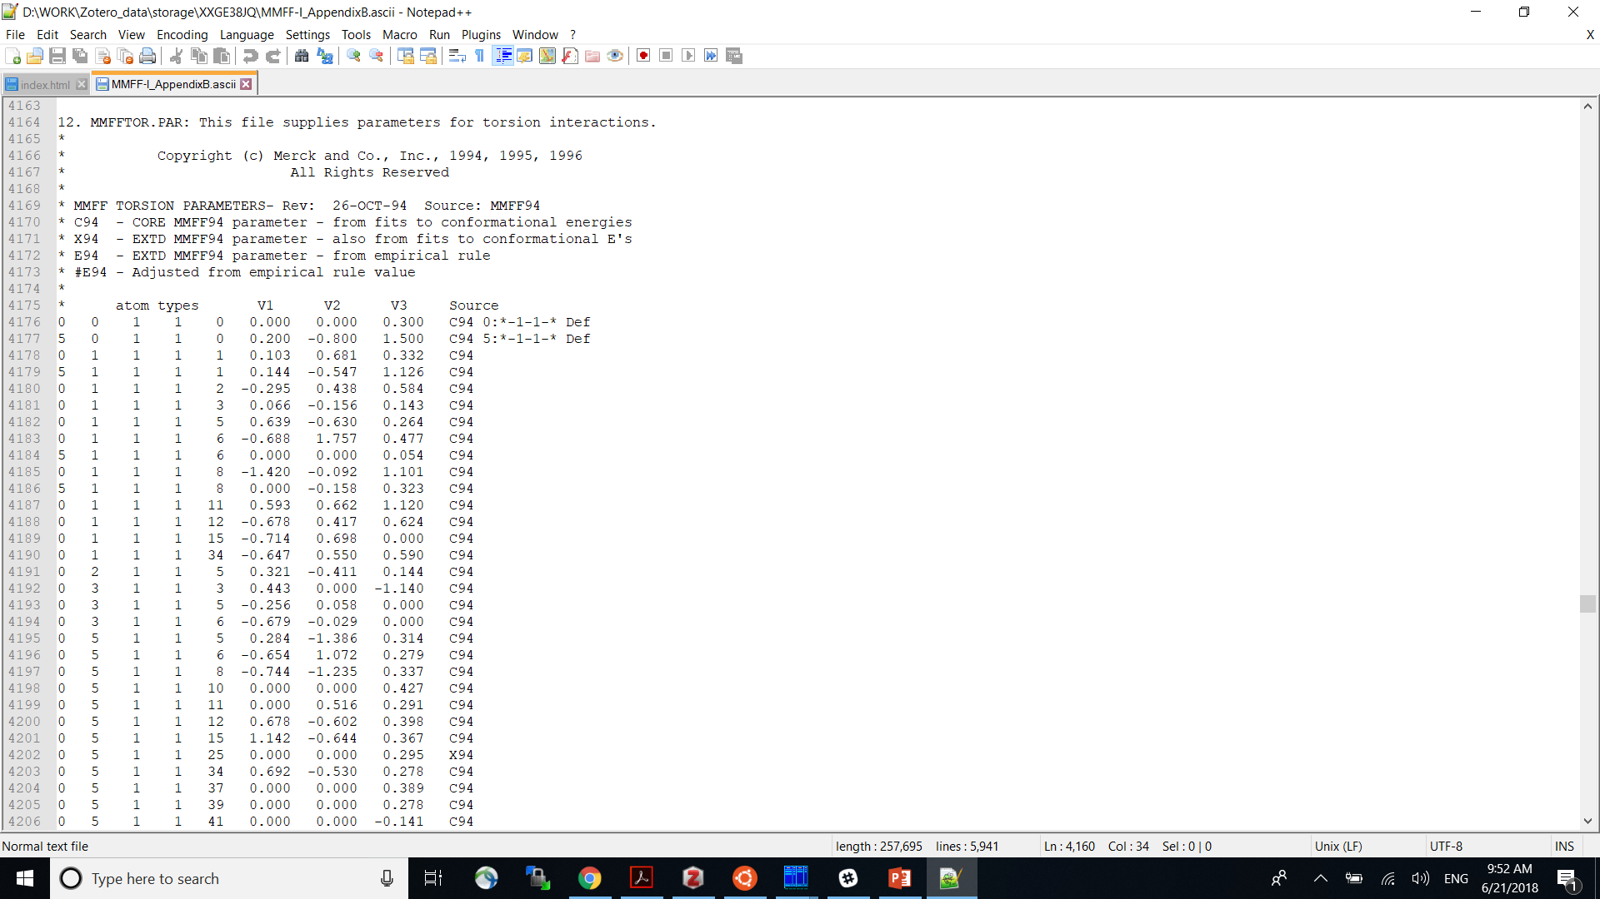
Parameterization: Specialized FFs
MERCK FF 94
Accurate
Focus on organic molecules
Many parameters!
Halgren, T. A. J. Comput. Chem. 1996, 17, 490–519.

Slide 10
Parameterization: General-purpose FFs
Universal FF (UFF)
Rappe, A. K.; Casewit, C. J.; Colwell, K. S.; Goddard III, W. A.; Skiff, W. M.
J. Am. Chem. Soc. 1992, 114, 10024–10035.
Not so accurate!
General purpose (e.g. organometallic)
Way fewer parameters!

Slide 11
Polarization: Charge equilibration method
Rappe, A. K.; Goddard, W. A. J. Phys. Chem. 1991, 95, 3358–3363.
electronegativity
self-Coloumb (idempotential)

Slide 12
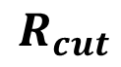
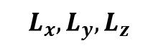
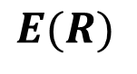
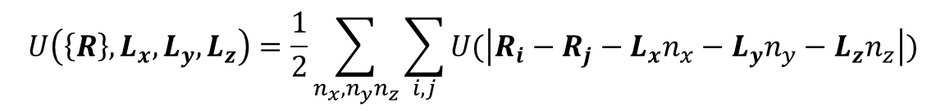

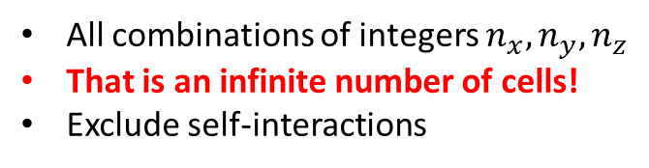
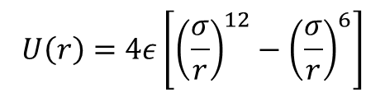
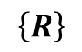
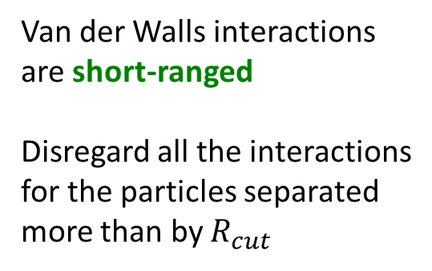
Handling vdW interactions with PBC
$$U\left(\left\{R\right\},L_{x},L_{y},L_{z}\right)=\frac{1}{2}\sum_{n_{x},n_{y}n_{z}}{\sum_{i,j}{U(\left|R_{i}−R_{j}−L_{x}n_{x}−L_{y}n_{y}−L_{z}n_{z}\right|)}}$$
All combinations of integers $n_{x},n_{y},n_{z}$
That is an infinite number of cells!
Exclude self-interactions
$$L_{x},L_{y},L_{z}$$
Simulation cell vectors
$$\left\{R\right\}$$
Atomic coordinates
Dealing with the infinite number of terms
$$E(R)$$
$$R_{cut}$$
Van der Walls interactions
are short-ranged
Disregard all the interactions
for the particles separated
more than by $R_{cut}$
$$R$$
$$U\left(r\right)=4ε\left[{\left(\frac{σ}{r}\right)}^{12}−{\left(\frac{σ}{r}\right)}^{6}\right]$$

Slide 13
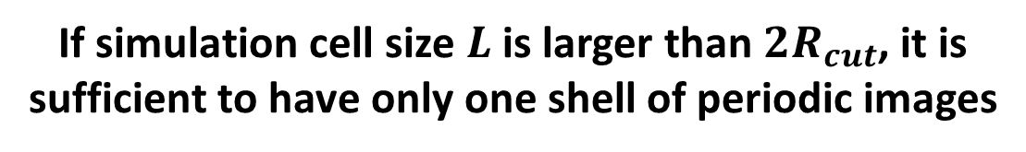
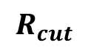
Handling non-bonded interactions with PBC
Simulation cell
Periodic Image
2’’
3’’
1
2
3
1’
2’
3’
$$R_{cut}$$
Same atom/molecule
If simulation cell size $L$ is larger than $2R_{cut}$, it is sufficient to have only one shell of periodic images

Slide 14
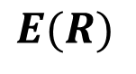

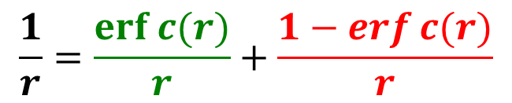
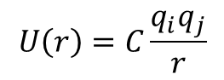
Handling electrostatic interactions with PBC
$$E(R)$$
$$U\left(r\right)=C\frac{q_{i}q_{j}}{r}$$
Electrostatic interactions
are long-ranged
Can not use the cutoff technique
Direct summation is slowly converging
$$R$$
$$\frac{1}{r}=\frac{erf⁡c(r)}{r}+\frac{1−erf⁡c(r)}{r}$$
Converges fast
in real space
Converges fast
in reciprocal space

Slide 15
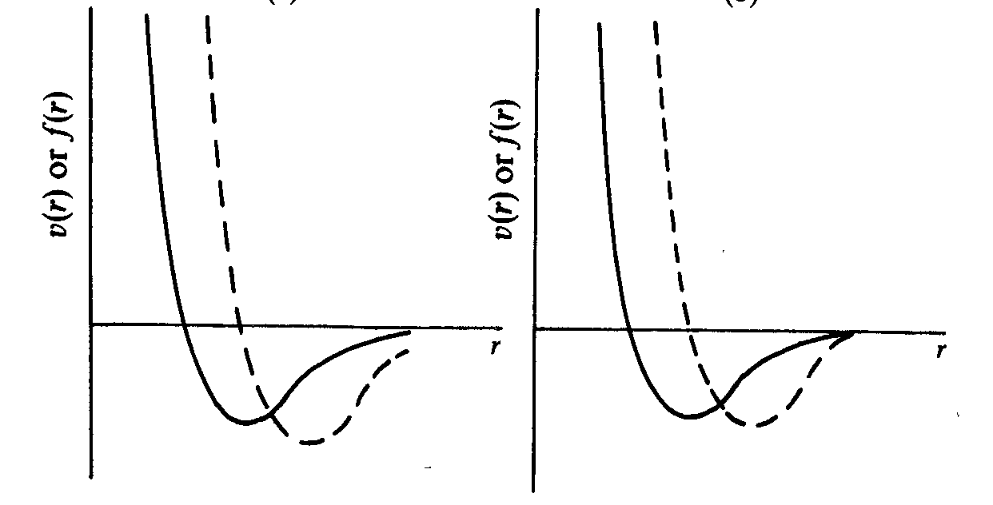
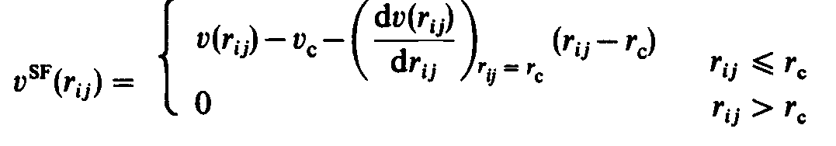
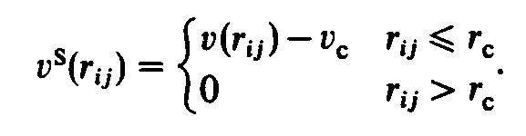
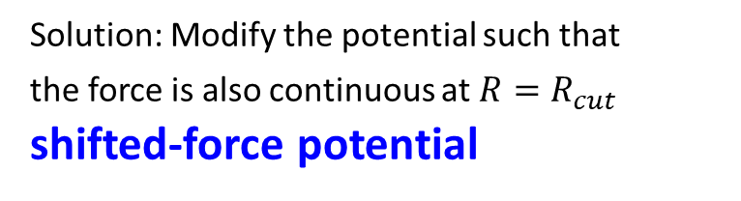
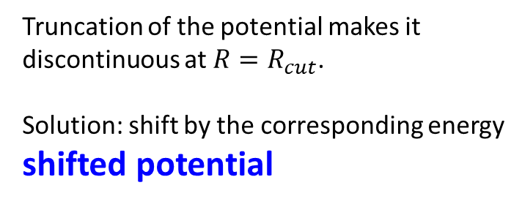
Continuity of forces
potential
force
Truncation of the potential makes it
discontinuous at $R=R_{cut}$.
Solution: shift by the corresponding energy
shifted potential
Solution: Modify the potential such that
the force is also continuous at $R=R_{cut}$ shifted-force potential
But the forces are still discontinuous!

Slide 16
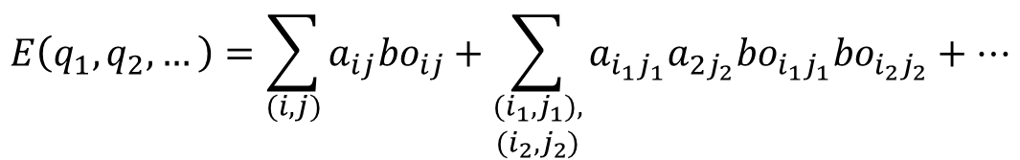
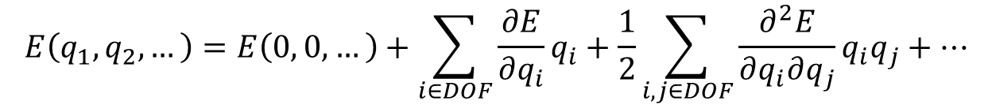
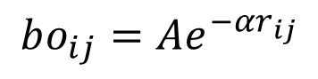
Classification of the FFs
$$E\left(q_{1},q_{2},…\right)=E\left(0, 0,…\right)+\sum_{i∈DOF}{\frac{∂E}{∂q_{i}}q_{i}}+\frac{1}{2}\sum_{i,j∈DOF}{\frac{∂^{2}E}{∂q_{i}∂q_{j}}q_{i}q_{j}}+…$$
Class I FFs: (diagonal terms): e.g. all bonds, all angles, etc.
Class II FFs: (+ cross-terms): e.g. add bond-angle interactions (e.g. like in MMFF94)
Bond-order (“reactive”) FFs:
$$E\left(q_{1},q_{2},…\right)=\sum_{(i,j)}{a_{ij}{bo}_{ij}}+\sum_{\begin{aligned}(i_{1},j_{1}), \\ (i_{2},j_{2})\end{aligned}}{a_{i_{1}j_{1}}a_{2j_{2}}{bo}_{i_{1}j_{1}}{bo}_{i_{2}j_{2}}}+…$$
$$bo_{ij}={Ae}^{−αr_{ij}}$$
Bond order
not the way it is defined in QM!

Slide 17
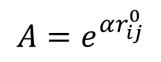
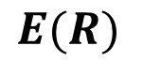
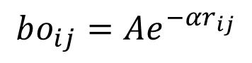

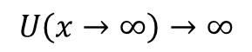
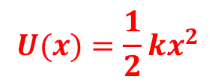
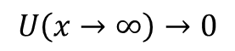
Reactive FFs
$$E(R)$$
Why bond order?
Harmonic potential:
$$U(x)=\frac{1}{2}kx^{2}$$
$$U\left(x→∞\right)→∞$$
$$R$$
Bond breaking is impossible!
Morse potential:
$$bo_{ij}={Ae}^{−αr_{ij}}$$
$$U\left(x\right)=D\left[e^{−2α\left(r_{ij}−r_{ij}^{0}\right)}−2e^{−α\left(r_{ij}−r_{ij}^{0}\right)}\right]=D[bo_{ij}^{2}−2bo_{ij}]$$
$$A=e^{αr_{ij}^{0}}$$
$$U\left(x→∞\right)→0$$
Physically correct limit: No interaction for infinitely separated atoms
Bond breaking is possible!

Slide 18
ReaxFF
van Duin, A. C. T.; Dasgupta, S.; Lorant, F.; Goddard, W. A. J. Phys. Chem. A 2001, 105, 9396–9409.

Slide 19
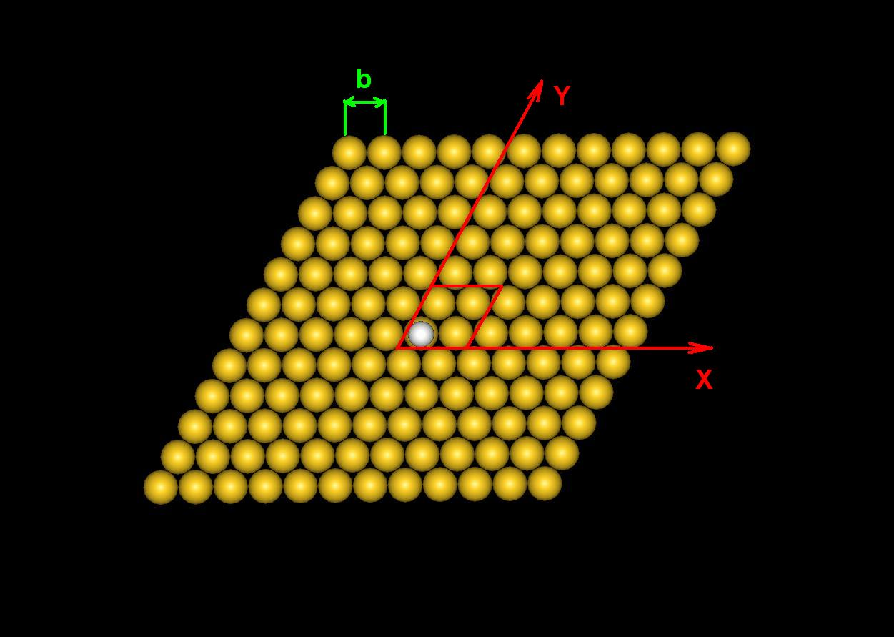
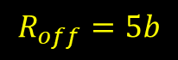
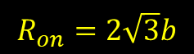
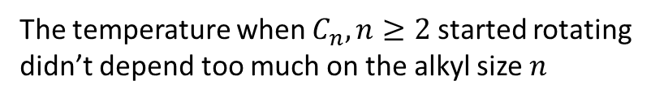
Constructing your own FF: Example 1
Physisorption: All atoms, except S
b=2.878 Å
$$R_{on}=2\sqrt{3}b$$
$$R_{off}=5b$$
Chemisorption: S atom
The temperature when $C_{n}, n≥2$ started rotating
didn’t depend too much on the alkyl size $n$

Slide 20
Constructing your own FF: Example 2
Akimov, A. V.; Williams, C.; Kolomeisky, A. B. J. Phys. Chem. C 2012, 116, 13816–13826.
Parameterization (PM6)
Validation
C60/Au diffusion coefficients

Slide 21
Materials modeling FFs
Embedded atom method (EAM)
Systems with non-directional bonds (metals, alloys)
Daw, M. S.; Baskes, M. I. Phys. Rev. Lett. 1983, 50, 1285−1288
Modified EAM (MEAM)
Introduced bond directionality
(silicon, etc.)
Baskes, M. I. Phys. Rev. Lett. 1987, 59, 2666−2669
Baskes, M. I.; Nelson, J. S.; Wright, A. F. Phys. Rev. B 1989, 40, 6085−6100.
MEAM92
Extended set of elements
(metals and non-metals)
Baskes, M. I. Phys. Rev. B 1992, 46, 2727−2742.
Brenner, Tersoff-Brenner, REBO
Brenner, D. W. Phys. Rev. B 1990, 42, 9458−9471
Reactive potentials for hydrocarbons
ReaxFF
Van Duin, A. C. T.; Dasgupta, S.; Lorant, F.; Goddard, W. A. J. Phys. Chem. A 2001, 105, 9396−9409
Charge-optimized many-body (COMBx)
Polarizable reactive potentials
Yu, J.; Sinnott, S.; Phillpot, S. Phys. Rev. B 2007, 75, 085311
Learn more:
Akimov, A. V.; Prezhdo, O. V. Chem. Rev. 2015, 115, 5797–5890.

Slide 22
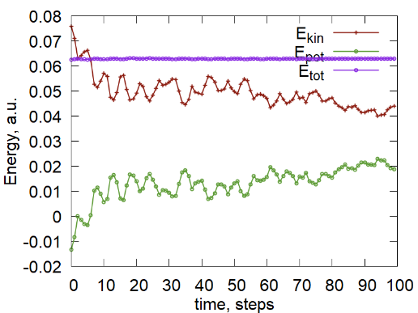
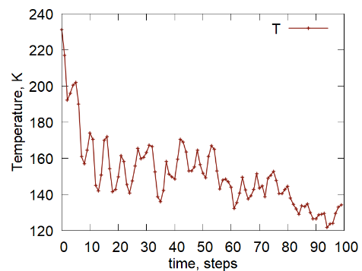
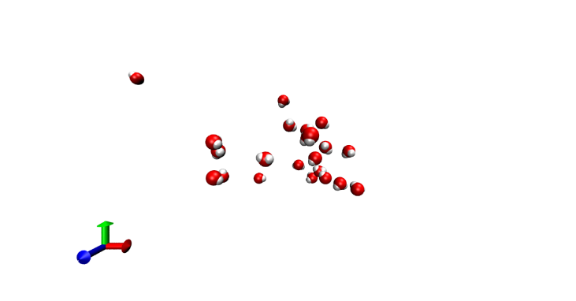
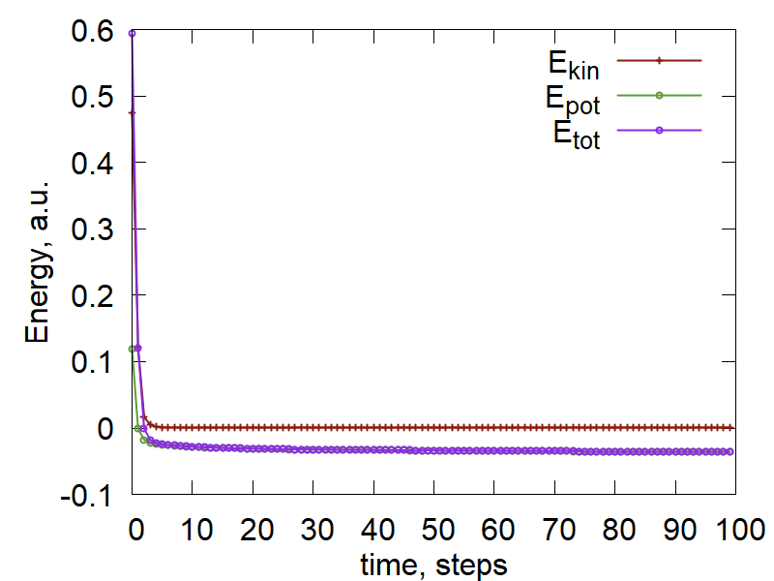
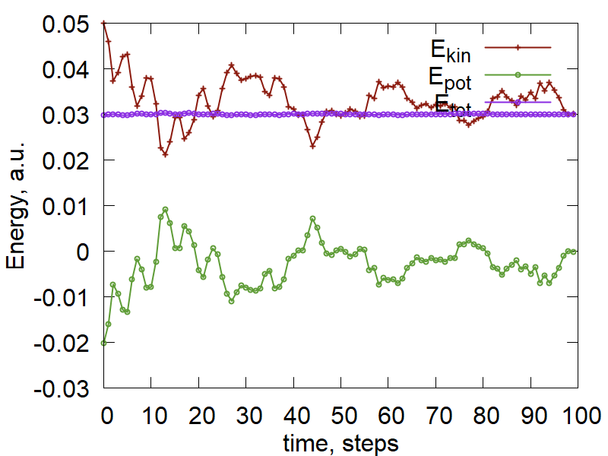
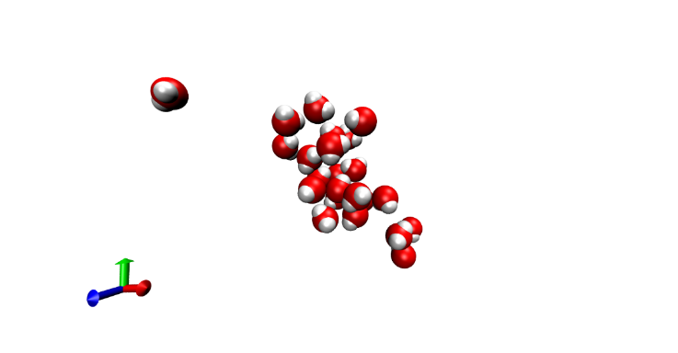
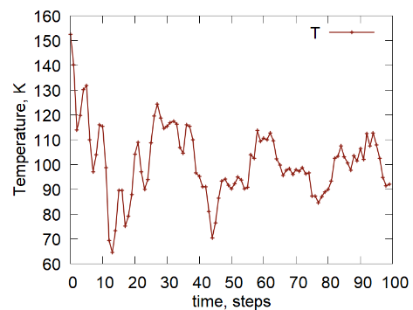
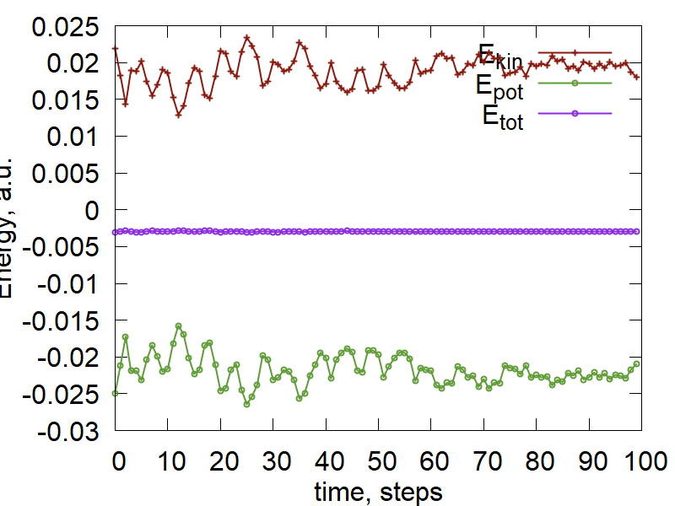
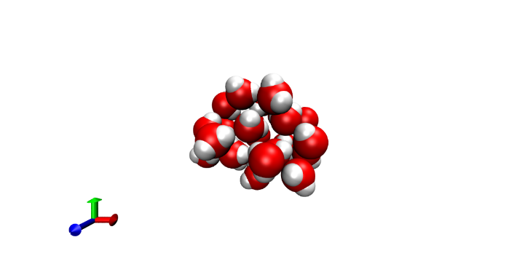
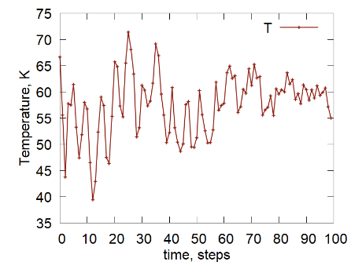
Exercises: Running AA MD of H2O cluster
Tut2.1
params["input_structure"] = "/23waters-aa.ent"
First, we cool the system down - optimization
T = 300 K
time = 5 ps
T = 200 K
Then, put some kinetic energy
T = 100 K

Slide 23
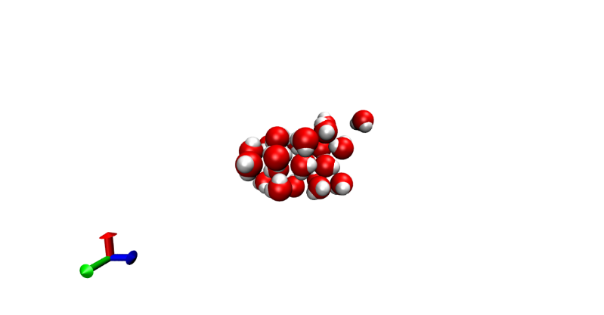
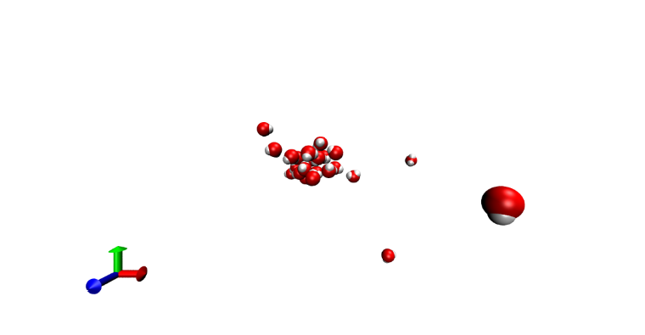



Exercises: Running RB MD of H2O cluster
Tut2.1
params["input_structure"] = "/23waters.ent"
Now, do the same, but remove internal degrees of freedom
$$E_{tot}=E_{bonded}+E_{non−bonded}$$
T = 100 K
T = 200 K
Using rigid-body molecular
dynamics (RB-MD)
Internal degrees of freedom
act as “energy buffer”
The kinetics in AA and RB
bay be very different!

Slide 24









Exercises: Running aa MD of SubPc/C60 cluster
This is the same as before, but using a predefined library
Use: run_aa_md.py
Tut2.2
Energy is well conserved
High T – behaves wildly
Assign T = 300 K after cooling
Internal degrees of freedom
“absorb” energy leading
to low temperature
Optimized
10 ps of MD

Slide 25




Exercises: Running aa MD of SubPc/C60 cluster
This is the same as before, but using another class
Use: run_aa_md_state.py
Tut2.2
Gives the same as before (NVE ensemble)
10 ps of MD
"ensemble":"NVT"
ST.set_thermostat(therm)
One N center inversion occurs

Slide 26








Exercises: Computing specific heat capacity of gold
Tut2.3
$$C_{V}=\frac{{\text{4}\text{.}\text{72}\text{∗10}}^{−4} Ha^{2}}{3.17∗{10}^{−6}\frac{Ha}{K}∗{278.0}^{2}K^{2}}=1.93∗{10}^{−3}\frac{Ha}{K}$$
$$m=\frac{216}{N_{A}}mol∗197\frac{g}{mol}=\frac{42552}{N_{A}}g=7.07∗{10}^{−20}g$$
$$c=\frac{C_{v}}{m}=\frac{1.93∗{10}^{−3}\frac{Ha}{K}}{7.07∗{10}^{−20}g }∗4.36∗{10}^{−18}\frac{J}{Ha}=1.19∗{10}^{−1}=0.119\frac{J}{g∗K}$$
Reference value:
0.129 $\frac{J}{g∗K}$

Slide 27









Normal modes analysis
m
m
$$\frac{d}{dt}\frac{∂L}{∂\dot{q_{i}}}−\frac{∂L}{∂q_{i}}=0$$
$$\frac{d}{dt}\frac{∂L}{∂\dot{q_{i}}}=\frac{∂L}{∂q_{i}}=−\frac{∂V}{∂q_{i}}$$
$$q_{1}$$
$$q_{2}$$
$$T=\frac{1}{2}m\left({\dot{q}}_{1}^{2}+{\dot{q}}_{2}^{2}\right)$$
$${m\ddot{q}}_{1}=−2k\left(q_{1}−q_{2}\right)$$
$$V=k{\left(q_{1}−q_{2}\right)}^{2}$$
$${m\ddot{q}}_{2}=2k\left(q_{1}−q_{2}\right)$$
$$det\left(\begin{matrix}2k−mω^{2} & −2k \\ −2k & 2k−mω^{2}\end{matrix}\right)={\left(2k−mω^{2}\right)}^{2}−4k^{2}=−4kmω^{2}+m^{2}ω^{4}=0 \\ mω^{2}=4k⇒ω=2\sqrt{\frac{k}{m}}$$

Slide 28






Normal modes analysis
m
M
m
$$q_{1}$$
$$q_{2}$$
$$q_{3}$$
$$q_{i}$$
are the displacements of all atoms in Cartesian coordinate system
$$T=\frac{1}{2}m\left({\dot{q}}_{1}^{2}+{\dot{q}}_{3}^{2}\right)+\frac{1}{2}M{\dot{q}}_{2}^{2}$$
Kinetic energy
$$U=\frac{1}{2}k{\left(q_{1}−q_{2}\right)}^{2}+\frac{1}{2}k{\left(q_{3}−q_{2}\right)}^{2}$$
Potential energy

Slide 29










Apply Lagrangian Equations of motion
$${m\ddot{q}}_{1}=k\left(q_{2}−q_{1}\right)$$
$${M\ddot{q}}_{2}=k\left(q_{1}−q_{2}\right)+k(q_{3}−q_{2})$$
$${m\ddot{q}}_{3}=k\left(q_{2}−q_{3}\right)$$
Search the solutions
in the form:
$$q_{i}=A_{i}\exp\left(iωt+δ_{i}\right)$$
$${−mω^{2}q}_{1}=k\left(q_{2}−q_{1}\right)$$
$${\left(−mω^{2}+k\right)q}_{1}−kq_{2}=0$$
$${−Mω^{2}q}_{2}=k\left(q_{1}−q_{2}\right)+k(q_{3}−q_{2})$$
$${−kq_{1}+\left(−Mω^{2}+2k\right)q}_{2}−kq_{3}=0$$
$$−{mω^{2}q}_{3}=k\left(q_{2}−q_{3}\right)$$
$$−kq_{2}+\left(−mω^{2}+k\right)q_{3}=0$$

Slide 30








Apply Lagrangian Equations of motion
$${−mω^{2}q}_{1}=k\left(q_{2}−q_{1}\right)$$
$${\left(−mω^{2}+k\right)q}_{1}−kq_{2}=0$$
$${−Mω^{2}q}_{2}=k\left(q_{1}−q_{2}\right)+k(q_{3}−q_{2})$$
$${−kq_{1}+\left(−Mω^{2}+2k\right)q}_{2}−kq_{3}=0$$
$$−{mω^{2}q}_{3}=k\left(q_{2}−q_{3}\right)$$
$$−kq_{2}+\left(−mω^{2}+k\right)q_{3}=0$$
$$\left(\begin{matrix}mω^{2}−k & k & 0 \\ k & Mω^{2}−2k & k \\ 0 & k & mω^{2}−k\end{matrix}\right)\left(\begin{matrix}q_{1} \\ q_{2} \\ q_{3}\end{matrix}\right)=\left(\begin{matrix}0 \\ 0 \\ 0\end{matrix}\right)$$
Non-trivial solution is when
det$\left(\begin{matrix}mω^{2}−k & k & 0 \\ k & Mω^{2}−2k & k \\ 0 & k & mω^{2}−k\end{matrix}\right)=$ =$\left(mω^{2}−k\right)\left[\left(Mω^{2}−2k\right)\left(mω^{2}−k\right)−k^{2}\right]−k\left[k\left(mω^{2}−k\right)\right]=$ $=\left(mω^{2}−k\right)$[$\left(Mω^{2}−2k\right)\left(mω^{2}−k\right)−2k^{2}]=0$

Slide 31



$$\left(Mω^{2}−2k\right)\left(mω^{2}−k\right)−2k^{2}=Mmω^{4}−2kmω^{2}−kMω^{2}=ω^{2}\left[Mmω^{2}−k\left(2m+M\right)\right]$$
Possible solutions
Normal modes
$$ω_{1}=0$$
(translation)
$$ω_{2}=\sqrt{\frac{k}{m}}$$
$$ω_{3}=\sqrt{\frac{k\left(2m+M\right)}{Mm}}$$

Slide 32






In a general form
$$T=\frac{1}{2}\sum_{i}{m_{i}{\dot{q}}_{i}^{2}}$$
Kinetic energy
$$V=V\left(q_{eq}\right)+\sum_{i}{\frac{∂V}{∂q_{i}}q_{i}}+\frac{1}{2}\sum_{i,j}{\frac{∂^{2}V}{∂q_{i}∂q_{j}}q_{i}q_{j}}$$
Potential energy
$$q_{i}=A_{i}\exp\left(iωt+δ_{i}\right)$$
$$\frac{d}{dt}\frac{∂L}{∂\dot{q_{i}}}−\frac{∂L}{∂q_{i}}=0$$
$$−m_{i}ω^{2}q_{i}+\sum_{i}{\frac{∂^{2}V}{∂q_{i}∂q_{k}}q_{k}}=0$$
$$\det\left|Mω^{2}−H\right|=0$$

